Slide 1
Practice Transformation
Tools for Practice Improvement

Slide 2
What is Practice Transformation?
The practice transformation initiative is one part of a strategy advanced by the Affordable Care Act to strengthen the quality of patient care and spend health care dollars more wisely. This training focuses on the Quadruple Aim and the 10 Building Blocks of High Performing Primary Care.
Objectives:
Understand the Quadruple Aim
Know the 10 Building Blocks
Apply these principles for improvement in your practice

Slide 3
The Quadruple AIM

Slide 4
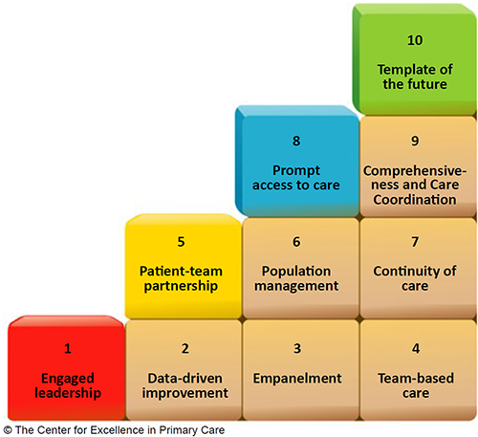
10 Building Blocks of High Performing Primary Care

Slide 5
Patient-Centered Medical Home
~~~~~~~~~~ The primary care medical home provides health care that is relationship-based with an emphasis on the whole person.
~~~~~~~~~~

Slide 6
Block 1. Engaged Leadership
Creating a Practice-wide Vision with Concrete Goals and Objectives
Engaged leadership to drive Practice Transformation
Sharing the vision
Leading with care
Leadership at all levels of the organization
Problem solving

Slide 7
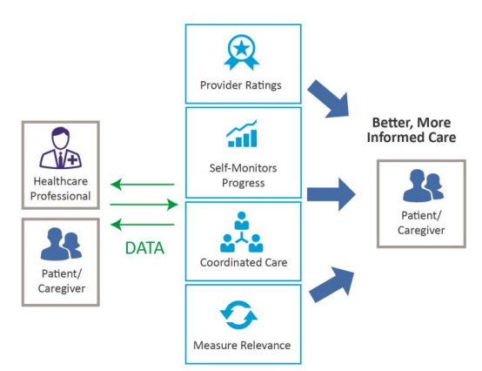
Block 2. Data-Driven Improvement
Data Driven Improvement Using Computer-Based Technology
Utilize EMR data for targeting populations and Social Determinants of Health
Define metrics for measuring improvement
Improve awareness, knowledge and skills about data analytics and the factors that influence outcomes
Optimize use of tools and/or technology that support data

Slide 8
Block 3. Empanelment
Empanelment - assigning individual patients to individual primary care providers (PCP) and care teams with sensitivity to patient and family preference - consider gender, class and cultural needs (cultural competencies).
Having responsibility for a specific panel of patients means care teams can track and monitor progress against goals on that population of patients. Empanelment also allows for more longitudinal patient-provider relationships, which in turn result in improved health outcomes.
Behavioral health needs
Cultural competencies
Health disparities across sub-populations
Provide training to increase cultural awareness, knowledge, and skills
Recruit and retain minority staff to address communication barriers

Slide 9
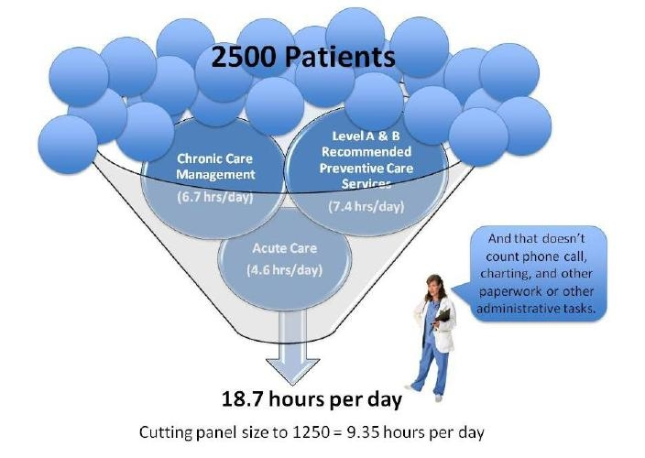
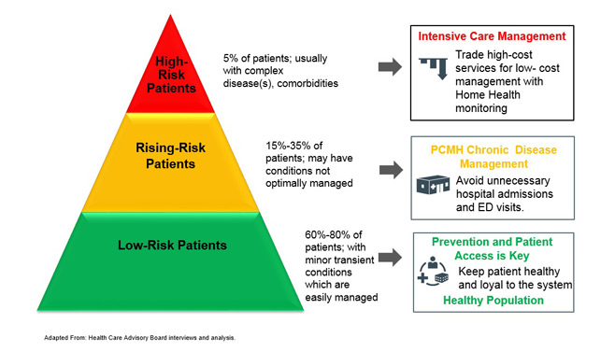
How to Manage the Patient Population

Slide 10
Block 4. Team-Based Care
Define workflows and workflow mapping
Defined roles with training, and skills checks to reinforce roles
Communication: team meetings, continuous interactions, warm handoffs
Integrated care for warm handoffs and continuity of care
Behavioral Health
Dental
Specialty Care

Slide 11
Block 5. Patient-Team Partnership
Evidenced-based care
Health Coaching
Informed, activated patients, able to advocate for themselves
Shared decision making that respects the patients personal goals

Slide 12
Block 6. Population Management
A systems approach – utilize data to identify health trends
Wrap patient for care coordination
Disease management
Build the relationship
Collect data and analyze for improved population management

Slide 13
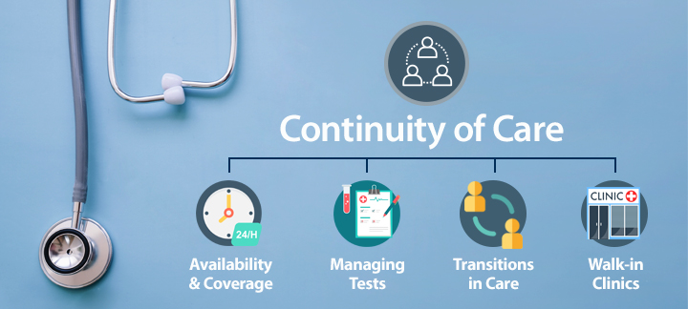
Block 7. Continuity of Care
Access to care
Access to patients own PCP
Access to specialists and behavioral health in the medical neighborhood

Slide 14
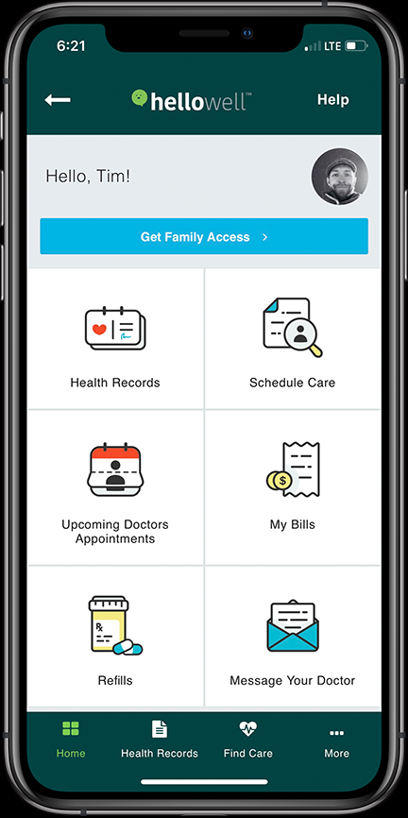
Block 8. Prompt Access to Care for Patients
Healthcare coverage
After hours availability – evenings and Saturday’s
On-call access to provider after hours
Same day appointments to reduce ER visits
E-mail access and access to patient records

Slide 15
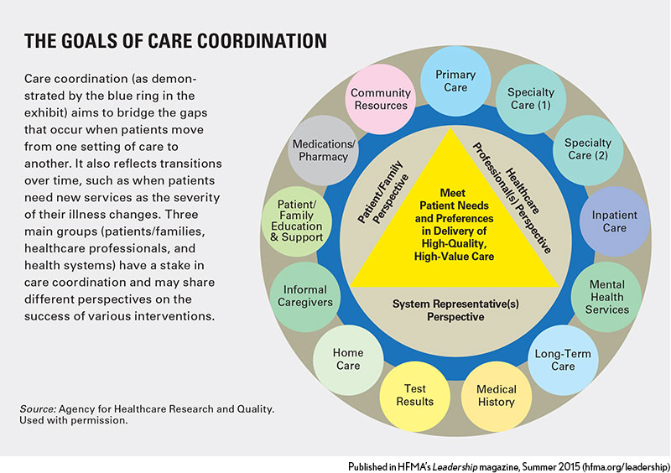
Block 9. Comprehensiveness and Care Coordination
Community partners
Referrals
Care transitions
Family and friends
Integrated Care – Integrating behavioral health into the medical home
Establish partnerships with the local BH organization and embed behavioral health staff on the care team
Warm handoffs

Slide 16
Block 10. Template of the Future
Telehealth visits – extending the reach of primary care providers
E-Consults
Remote patient monitoring
Group visits
Multiple services at one location for convenience and continuity

Slide 17
Putting it all Together…
Watch the Ted Talk
‘Healthcare Should be a Team Sport’
https://www.ted.com/talks/eric_dishman_health_care_should_be_a_team_sport?utm_campaign=tedspread&utm_medium=referral&utm_source=tedcomshare

Slide 18
Activity
Now that you have studied each of the building blocks, we will ask you to apply what you have learn for this exercise.
Change for Improvement
Identify one area for you and/or the care team to improve on.
List the steps to take to make this change for improvement.
Set a date for when you will complete this aim or goal.
Create an aim statement.
Examples:
By July 30, 2019, we will review and update the assessment form, to provide better patient engagement.
By August 15, 2019, we will review and update our transitions of care plan to ensure that we are providing continuity of care.
Follow up with documentation to identify your observations or changes. Did you see a change for improvement? Do you need to make further changes to accomplish your aim for improvement?
Share your aim statement and your outcomes in the discussion forum in Canvas

